Slide 1



I CAN WRITE NUMBERS
TO

Slide 2
Count the number of snakes you can see:

Slide 3
Start at the top, make a circle, that's the way to make a zero.
Practise writing the number 0 by tracing the gray line:

Slide 4

Count the number of walruses you can see:

Slide 5

Start at the top, straight and tall, that's the way to make a one.
Practise writing the number 1 by tracing the gray line:

Slide 6

Count the number of alligators you can see:

Slide 7
Start at the top, curve around just right, that's the way to make a two.
Practise writing the number 2 by tracing the gray line:

Slide 8
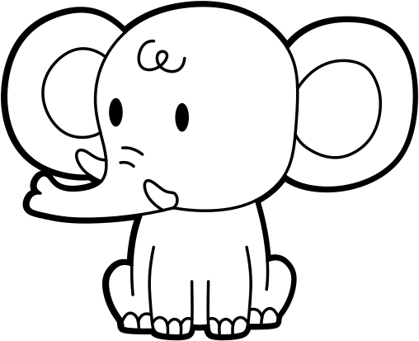
Count the number of elephants you can see:

Slide 9

Start at the top, curve around and then, that's the way to make a three.
Practise writing the number 3 by tracing the gray line:

Slide 10

Count the number of cats you can see:

Slide 11

Down and over, down once more, that's the way to make a four.
Practise writing the number 4 by tracing the gray line:

Slide 12

Count the number of mice you can see:

Slide 13

Down and around, then give it a hat, that's the way to make a five.
Practise writing the number 5 by tracing the gray line:

Slide 14

Count the number of goats you can see:

Slide 15

Start at the top, curve around and then, loop back to make a six.
Practise writing the number 6 by tracing the gray line:

Slide 16

Count the number of hippos you can see:

Slide 17

Across the sky and down from heaven, that's the way to make a seven.
Practise writing the number 7 by tracing the gray line:

Slide 18

Count the number of turtles you can see:

Slide 19

Make an 'S' and don't be late, that's the way to make an eight.
Practise writing the number 8 by tracing the gray line:

Slide 20

Count the number of jaguars you can see:

Slide 21

Circle around and then a line, that's the way to make a nine.
Practise writing the number 9 by tracing the gray line:

Slide 22

Count the number of narwhals you can see:

Slide 23
Practise writing the number 10 by tracing the gray line:

Slide 24

Count the number of zebras you can see:

Slide 25
Practise writing the number 11 by tracing the gray line:

Slide 26

Count the number of lions you can see:

Slide 27
Practise writing the number 12 by tracing the gray line:

Slide 28

Count the number of ants you can see:

Slide 29
Practise writing the number 13 by tracing the gray line:

Slide 30
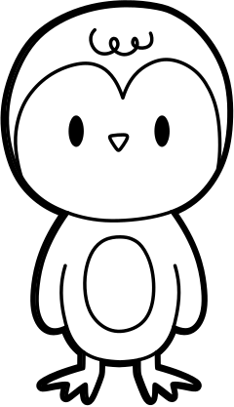
Count the number of penguins you can see:

Slide 31
Practise writing the number 14 by tracing the gray line:

Slide 32

Count the number of dogs you can see:

Slide 33
Practise writing the number 15 by tracing the gray line:

Slide 34
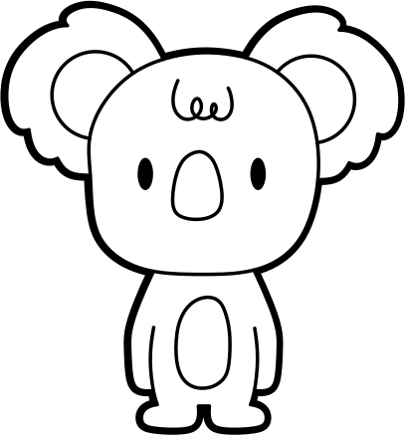
Count the number of koalas you can see:

Slide 35
Practise writing the number 16 by tracing the gray line:

Slide 36

Count the number of unicorns you can see:

Slide 37
Practise writing the number 17 by tracing the gray line:

Slide 38

Count the number of sloths you can see:

Slide 39
Practise writing the number 18 by tracing the gray line:

Slide 40
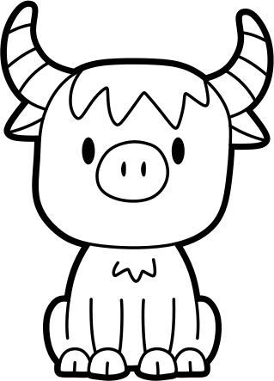
Count the number of yaks you can see:

Slide 41
Practise writing the number 19 by tracing the gray line:

Slide 42

Count the number of horses you can see:

Slide 43
Practise writing the number 20 by tracing the gray line:

Slide 44

CONGRATULATIONS!
YOU ARE A NUMBER WRITING HERO!

